Slide 1
Misclassification Results
Notebook 18Misclassification

Slide 2
Try this:
Please print your misclassification results from your homework

Slide 3
Convolutional Neural Network Techniques
Dr. Mongkol Ekpanyapong

Slide 4
What is Data Augmentation?
The goal is to increase the generalizability of the model.
During the training, we provide slightly modified versions of the input data points
At testing time, we do not apply data augmentation

Slide 5
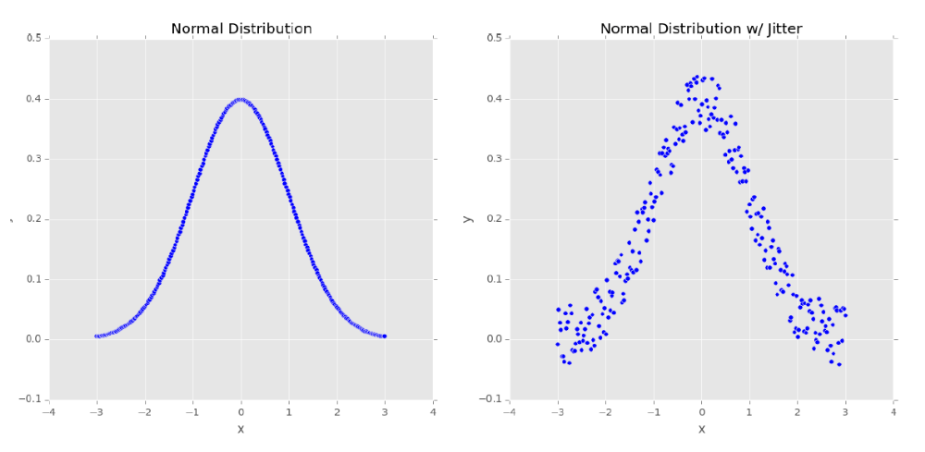
Networks as Feature Extractors
A normal distribution With jitter

Slide 6
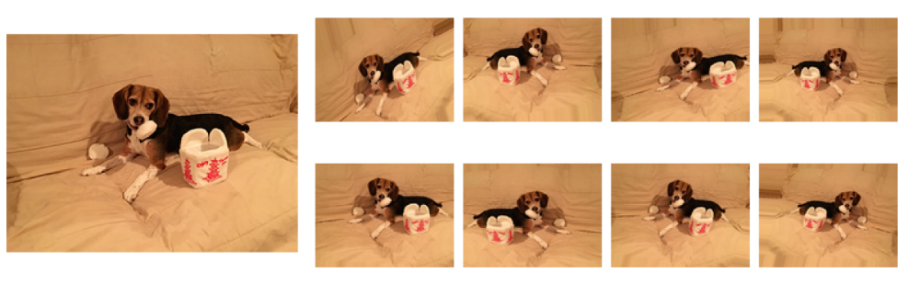
Data Augmentation
One of the most effective way of reducing overfitting
It also helps addressing of not having enough data or enough variation

Slide 7
Data Augmentation Variety
Flipping (Horizontal/Vertical)
Brightness
Rotations
Zoom
Cropping
Skew/Sheer

Slide 8
Data Augmentation
Only done during training
Turn it off during validation/testing
Supports are provided both Keras and Pytorch

Slide 9
Example
train_datagen = ImageDataGenerator(
rescale = 1./255,
rotation_range=10,
width_shift_range=0.1,
height_shift_range=0.1,
shear_range=0.1,
zoom_range=0.1,
horizontal_flip=True,
fill_mode='nearest')

Slide 10
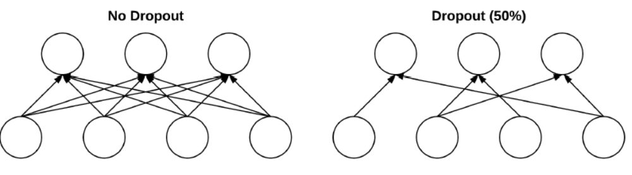
Dropout
The dropout is a regularization technique
The idea is to keep turn off some neural so that we use many good neural nodes for prediction (not relying only on one)
It provides multiple redundant nodes

Slide 11

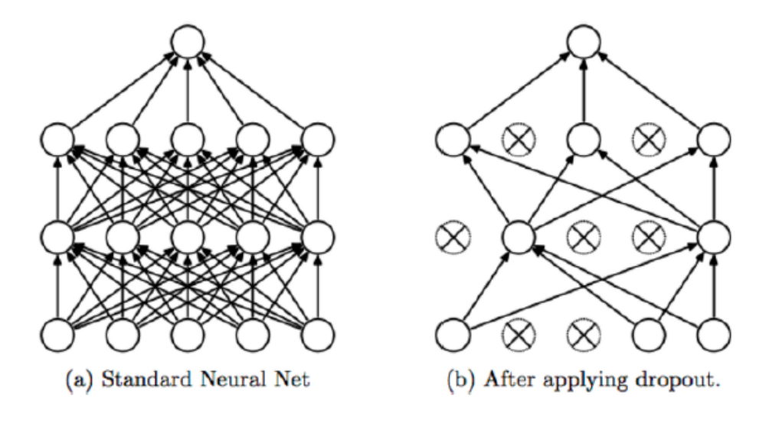
Dropout Example

Slide 12
Dropout
Note that we randomly add dropout only during the training time,(testing time, we activate back all nodes)
Model:
INPUT => CONV => RELU => BN => POOL => FC => DO => FC => DO

Slide 13
Example
model.add(Dropout(0.2))

Slide 14
Batch Normalization (BN)
Recall- the output of CNN is
Batch size x Feature Map Height x Feature Map Width x Channels
BN calculates the mean and standard deviation of each input variable, to a layer per mini-batch and uses this to perform the standardization

Slide 15
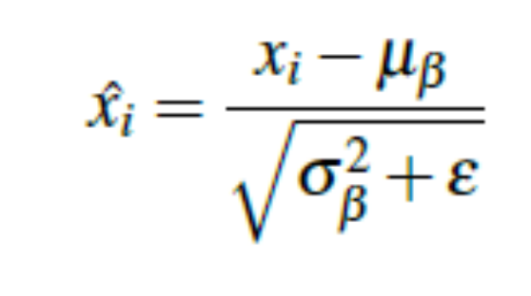
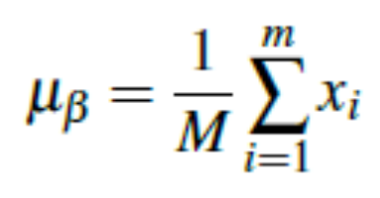
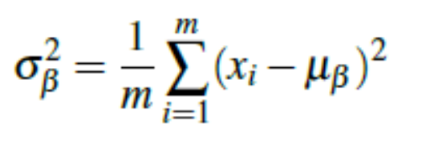
Batch Normalization
It is introduced by Ioffe and Szegedy in 2015 paper, Batch Normalization: Accelerating Deep Network Training by Reducing Internal Covariate Shift to add BN layer
The idea is to normalize the data where x_{i} is mini-batch
The equation is as follow:
when

Slide 16
Batch Normalization
Advantage:
  Help reduce the number of epochs for training and help for regularization
  Recommend to put wherever we can
Drawback:
  Slow down the system
Model:
INPUT => CONV => RELU => BN => POOL => FC

Slide 17
Example
model.add(BatchNormalization())

Slide 18
Rule of Training The Model
Reduce the training loss as much as possible
Ensuring the gap between the training and testing is small

Slide 19
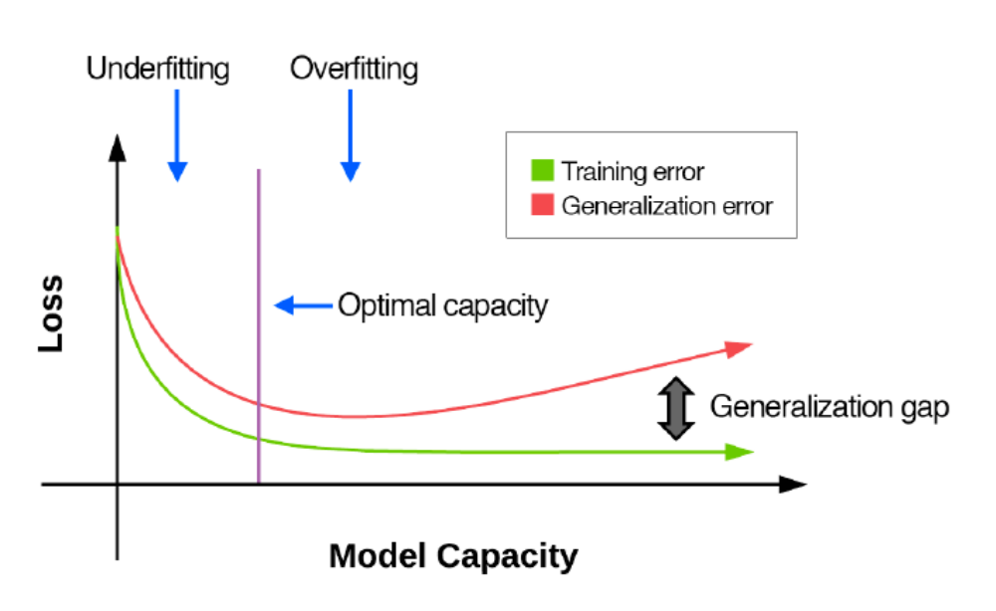
Controlling A Model
Model capacity is the capacity of the neural network, e.g., # layers

Slide 20
Model Capacity
We can increase capacity by:
  adding more layers and neurons
We can decrease capacity by:
  Removing layers and neurons
  Applying regularization techniques (weight decay, dropout, data augmentation, early stopping, etc.)

Slide 21
Can validation loss be lower than training loss?

Slide 22
Why?
Your training data is seeing all the “hard” examples while your validation data consists of easy data points
You perform data augmentation during the training
You are not training hard enough

Slide 23
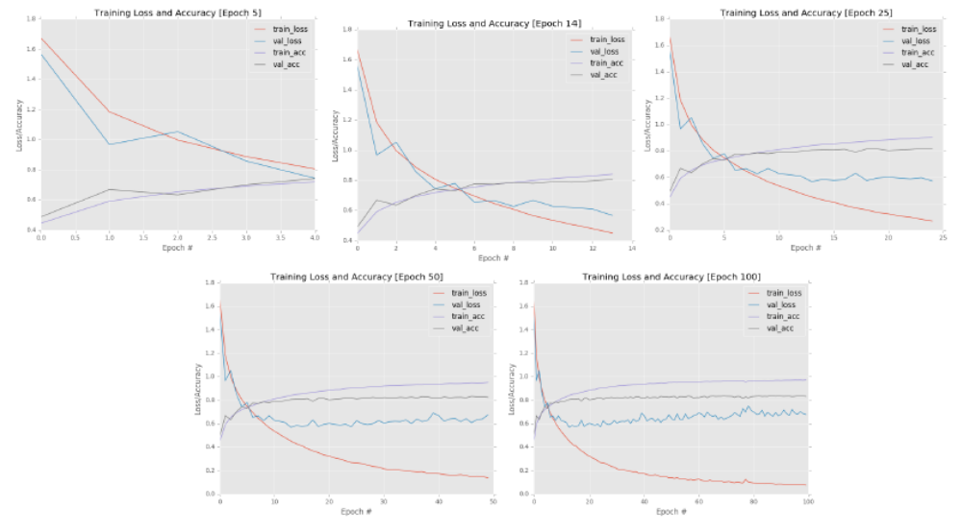
Spotting the Training/Validation

Slide 24
Example of Regularization in Keras
Notebook 19 Regularization

Slide 25
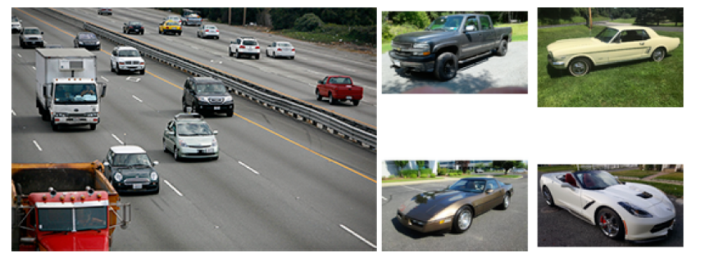
Example of Data Training
Left: cars on a highway (our problem)
Right: train images

Slide 26
What is the problem?

Slide 27
Optimal Pathway to Apply Deep Learning
“Most issues in applied deep learning come from training data/testing data mismatch. In some scenarios this issue just doesn’t come up, but you’d be surprised how often applied machine learning projects use training data (which is easy to collect and annotate) that is different from the target application.”,
-Andrew Ng

Slide 28

Training, Validation, Test
Training data is what we use to optimize the model parameters
Validation data is to provide an unbiased evaluation during training
Testing data is an unseen data test on actual scenario

Slide 29
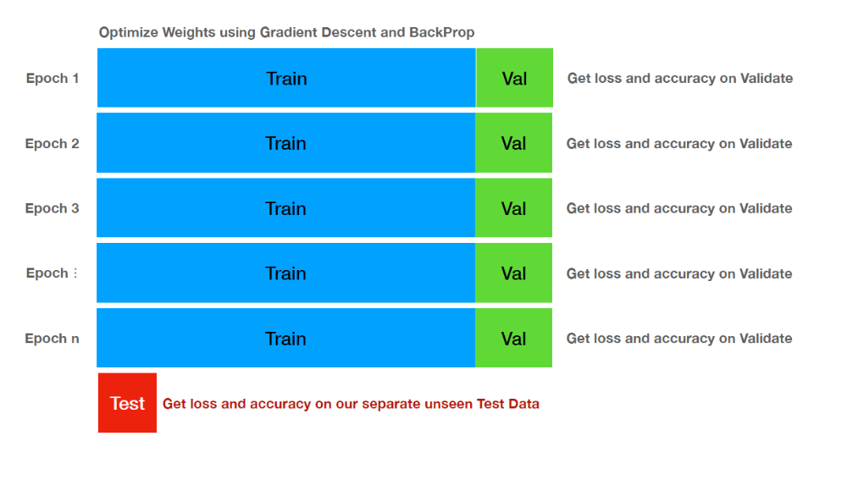
Example

Slide 30
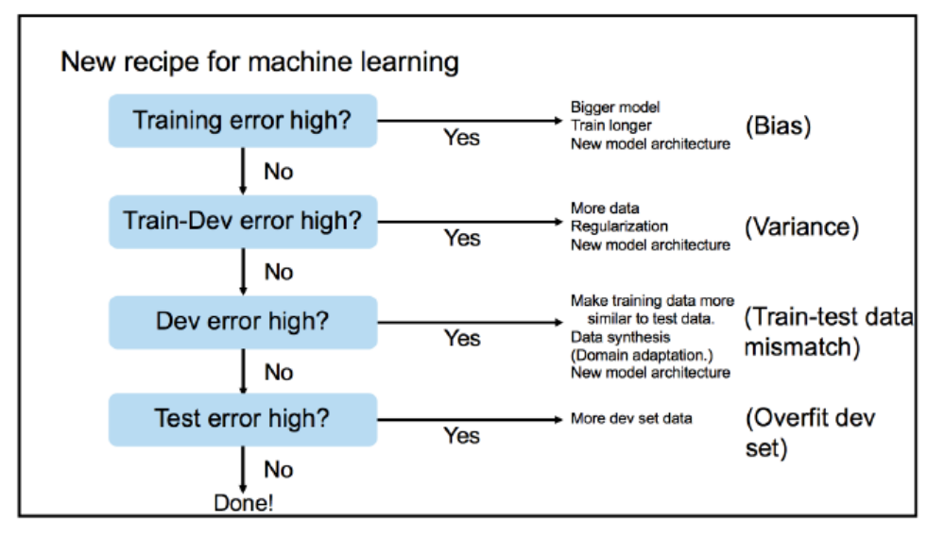

Slide 31
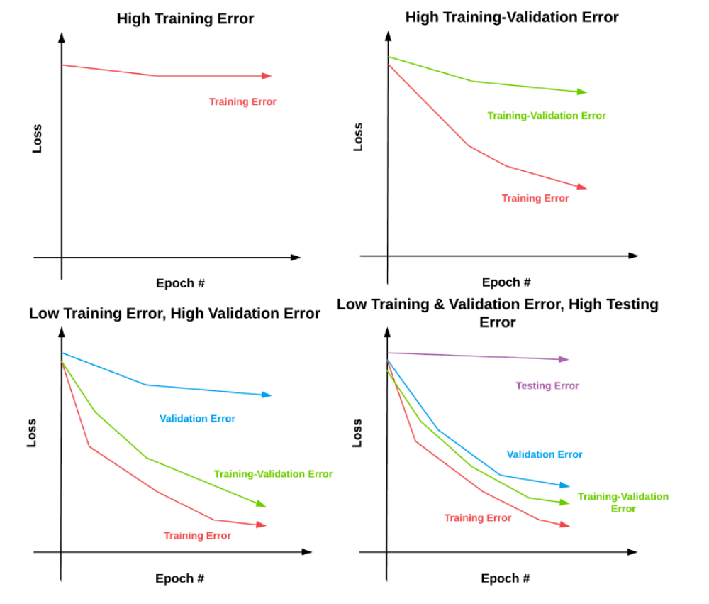
Andrew Ng’s Training Receipe

Slide 32
Training on Mnist-cloth
import numpy as np
import os
import sys
assert sys.version_info >= (3, 5)
# Scikit-Learn ≥0.20 is required
import sklearn
import matplotlib as mpl
import matplotlib.pyplot as plt
import tensorflow as tf
from tensorflow import keras
mpl.rc('axes', labelsize=14)
mpl.rc('xtick', labelsize=12)
mpl.rc('ytick', labelsize=12)

Slide 33
# Where to save the figures
PROJECT_ROOT_DIR = "."
CHAPTER_ID = "ann"
IMAGES_PATH = os.path.join(PROJECT_ROOT_DIR, "images", CHAPTER_ID)
os.makedirs(IMAGES_PATH, exist_ok=True)
def save_fig(fig_id, tight_layout=True, fig_extension="png", resolution=300):
path = os.path.join(IMAGES_PATH, fig_id + "." + fig_extension)
print("Saving figure", fig_id)
if tight_layout:
plt.tight_layout()
plt.savefig(path, format=fig_extension, dpi=resolution)
tf.__version__
keras.__version__

Slide 34
fashion_mnist = keras.datasets.fashion_mnist
(X_train_full, y_train_full), (X_test, y_test) = fashion_mnist.load_data()
X_train_full.shape
X_train_full.dtype
X_valid, X_train = X_train_full[:5000] / 255., X_train_full[5000:] / 255.
y_valid, y_train = y_train_full[:5000], y_train_full[5000:]
X_test = X_test / 255.
plt.imshow(X_train[0], cmap="binary")
plt.axis('off')
plt.show()
y_train
class_names = ["T-shirt/top", "Trouser", "Pullover", "Dress", "Coat",
"Sandal", "Shirt", "Sneaker", "Bag", "Ankle boot"]

Slide 35
class_names[y_train[0]]
X_valid.shape
X_test.shape
n_rows = 4
n_cols = 10
plt.figure(figsize=(n_cols * 1.2, n_rows * 1.2))
for row in range(n_rows):
for col in range(n_cols):
index = n_cols * row + col
plt.subplot(n_rows, n_cols, index + 1)
plt.imshow(X_train[index], cmap="binary", interpolation="nearest")
plt.axis('off')
plt.title(class_names[y_train[index]], fontsize=12)
plt.subplots_adjust(wspace=0.2, hspace=0.5)
save_fig('fashion_mnist_plot', tight_layout=False)
plt.show()

Slide 36
model = keras.models.Sequential()
model.add(keras.layers.Flatten(input_shape=[28, 28]))
model.add(keras.layers.Dense(300, activation="relu"))
model.add(keras.layers.Dense(100, activation="relu"))
model.add(keras.layers.Dense(10, activation="softmax"))
keras.backend.clear_session()
np.random.seed(42)
tf.set_random_seed(42)
model = keras.models.Sequential([
keras.layers.Flatten(input_shape=[28, 28]),
keras.layers.Dense(300, activation="relu"),
keras.layers.Dense(100, activation="relu"),
keras.layers.Dense(10, activation="softmax")
])
model.layers
model.summary()
from keras.utils import plot_model

Slide 37
# plot_model(model, "my_fashion_mnist_model.png")
hidden1 = model.layers[1]
hidden1.name
model.get_layer(hidden1.name) is hidden1
weights, biases = hidden1.get_weights()
weights
weights.shape
biases
biases.shape
model.compile(loss="sparse_categorical_crossentropy",
optimizer="sgd",
metrics=["accuracy"])
history = model.fit(X_train, y_train, epochs=30,
validation_data=(X_valid, y_valid))
history.params
print(history.epoch)
history.history.keys()
import pandas as pd

Slide 38
pd.DataFrame(history.history).plot(figsize=(8, 5))
plt.grid(True)
plt.gca().set_ylim(0, 1)
save_fig("keras_learning_curves_plot")
plt.show()
model.evaluate(X_test, y_test)
X_new = X_test[:3]
y_proba = model.predict(X_new)
y_proba.round(2)
y_pred = model.predict_classes(X_new)
y_pred
np.array(class_names)[y_pred]
y_new = y_test[:3]
y_new

Slide 39
plt.figure(figsize=(7.2, 2.4))
for index, image in enumerate(X_new):
plt.subplot(1, 3, index + 1)
plt.imshow(image, cmap="binary", interpolation="nearest")
plt.axis('off')
plt.title(class_names[y_test[index]], fontsize=12)
plt.subplots_adjust(wspace=0.2, hspace=0.5)
save_fig('fashion_mnist_images_plot', tight_layout=False)
plt.show()

Slide 40
Homework
From Mnist-cloth, try to build your own CNN model to outperform FCN given in the example.

Slide 41
Questions?

